Slide 1
Lecture 8 Integer Linear Programming

Slide 2
Agenda
Integer Linear Programming
When integer solutions matter
Types of integer programming problems
Solving integer programming problems
Modeling Flexibility of Binary Decision Variables
Logical constraints: Salem City Council Example
Fixed costs and capacity constraints: STECO Warehouse Example
Quantity thresholds
Summary

Slide 3
When Integer Solutions Matter
Airplanes, buildings, persons, projects, …
But also yes/no decisions …
Suppose, for example, that the optimal solution to a linear program calls for opening 0.5 warehouses in St. Louis.
This is a ``yes/no” decision (0=no, 1=yes) and simply rounding off 0.5 to 0 or 1 changes the result of our analysis very dramatically.
Therefore an integer linear program is needed.

Slide 4
Types of Integer Programming Models

Slide 5
An All-integer Programming Problem
LP Relaxation
drop the integer constraints from the integer linear programming formulation
Max 1200 x₁ + 2000 x₂
s.t.
2x₁ + 6 x₂ ≤ 27
x₂ ≥ 2
3x₁ + x₂ ≤ 19
x₁ , x₂ ≥ 0 and Integer
LP Relaxation Optimal
x₁ = 5 ⁷/₁₆
x₂ = 2 ¹¹/₁₆
_{Optimal OBJ value = 11900}
1200x₁ + 2000 x₂
2x₁ + 6 x₂ ≤ 27
X₁ ≥0
3x₁ + x₂ ≤ 19
X₂ ≥ 2

Slide 6
Solving Integer Programming Problem
LP relaxation, then round to integers?
Round off ?
x₁ = 5
x₂ = 3
Max 1200 x₁ + 2000 x₂
s.t.
2x₁ + 6 x₂ ≤ 27
x₂ ≥ 2
3x₁ + x₂ ≤ 19
x₁ , x₂ ≥ 0 and Integer
Round up ?
x₁ = 6
x₂ = 3
Round down ?
x₁ = 5
x₂ = 2
LP Relaxation Optimal
x₁ = 5 ⁷/₁₆
x₂ = 2 ¹¹/₁₆
x₁=6
x₂=2

Slide 7
Solving Integer Programming Problem
IP Optimal
x₁ = 4
x₂ = 3
LP Relaxation Optimal
x₁ = 5 ⁷/₁₆
x₂ = 2 ¹¹/₁₆
LP relaxation gives an upper bound for Maximization Problem
LP relaxation gives a lower bound for Minimization Problem

Slide 8
Possible Solution Methods
Enumeration
Will yield the optimal solution
Time consuming
Branch and Bound
Used by most software packages (incl. Excel)
Will yield the optimal solution
More efficient than enumeration

Slide 9
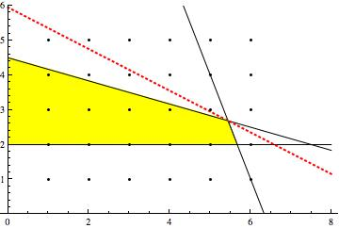
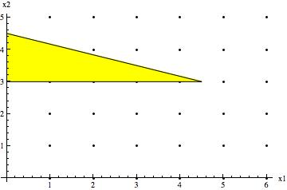
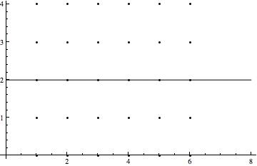
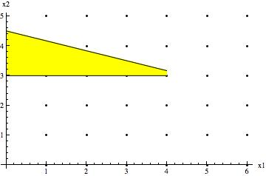
Branch and Bound Solution
LP Relaxation
OBJ. Funct. Val.=11900
X₁=5+(7/16), x₂=2+(11/16)
Branching on x₂
Add constraint: x₂ ≤ 2
Add constraint: x₂ ≥ 3
✗
OBJ. Funct. Val.=10,800
x₁=17/3, x₂=2
OBJ. Funct. Val.=11,400
x₁=9/2, x₂=3
Branching on x₁
Add constraint: x₁≤ 4
Add constraint: x₁ ≥ 5
✗
✔
OBJ. Funct. Val.=10800
x₁=4, x₂=3
Solution Infeasible!!!
Remember one of the most fundamental insights of linear programming: as soon as an additional constraint is added to a maximization problem, the objective function value STAYS THE SAME OR IT DECREASES. (Why?)

Slide 10
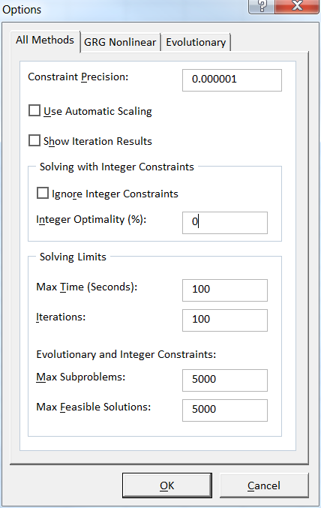
Solving IP in Excel
1. Add integer constraints
2. Solver Options: Set 0 for Integer Optimality (%) to find the true optimal solution
3. Solver DOES NOT provide Sensitivity Report.
4. To answer sensitivity questions, re-run computer program using updated information
The limit may need to be increased for larger IP models

Slide 11
Binary (0/1) Variables and Binary Choice Models
1 accept Project i
0 reject Project i
x_{i} = Indicator for Project i =
1. Mutually Exclusive Constraint
Example: Can’t select both Project 1 and Project 3
2. Co-requisite Projects Constraint
Example: Project 1 and Project 2 have to be selected together
3. Prerequisite Projects Constraint
Example: Project 4 cannot be selected unless Project 2 is selected, but if Project 2 is selected, Project 4 can be not selected
4. K out of N Projects Constraint
Example: Must Choose at least one of Projects 5, 6, 7
 | x₁ | x₃
 | 0 | 0
 | 0 | 1
 | 1 | 0
 | 1 | 1
x₁ + x₃ ≤ 1
 | x₁ | x₂
 | 0 | 0
 | 0 | 1
 | 1 | 0
 | 1 | 1
x₁ = x₂ or x₁ - x₂ = 0
 | x₂ | x₄
 | 0 | 0
 | 0 | 1
 | 1 | 0
 | 1 | 1
x₄ ≤ x₂ or x₄ - x₂ ≤ 0
x₅ + x₆ + x₇ ≥ 1

Slide 12
Capital Budgeting & Logical Relationships-Salem City Council
Decision Variables
Objective Function
Binary decision variables, X₁, X₂, … X₉ :
X_{j} = 1 if project j is funded
X_{j} = 0 if project j is not funded
Maximize Overall point score of the funded projects
MAX 4176 X₁+ 1774 X₂+2513 X₃+ 1928 X₄+ 3607 X₅+ 962 X₆
+ 2829 X₇+1708 X₈+ 3003 X₉

Slide 13
Salem City Council Problem
Constraints
1.
2.
3.

Slide 14
Salem City Council Problem
Constraints:
4.
5.

Slide 15
Fixed Costs and Capacity Constraints -STECO’s Warehouse Location
Decision Variables
Objective Function

Slide 16
STECO Warehouse Problem
Constraints
Warehouse nodes:
District nodes:

Slide 17
Fixed Costs & Capacity Constraints – Toy-R-4-U
The Toys-R-4-U Company has developed two new toys for possible inclusion in its product line for the upcoming Christmas season.
The company has two factories that are capable of producing these toys. Setting up the production facilities to begin production would cost $50,000 for Toy 1 and $80,000 for Toy 2. That is, if Toy 1 is set up to be produced in factory 1, then $50,000 will be incurred. If Toy 1 is also set up to be produced in factory 2, then another $50,000 will be incurred. Same logic applies to Toy 2. The unit profit of Toy 1 is $10, and the unit profit of Toy 2 is $15.
Toy 1 can be produced at the rate of 50 units per hour in factory 1 and 40 units per hour in factory 2. Toy 2 can be produced at the rate of 40 units per hour in factory 1 and 25 units per hour in factory 2. Factories 1 and 2, respectively, have 500 hours and 700 hours of production time available before Christmas that could be used to produce these toys.
Formulate a Mixed Integer LP to determine how many units (if any) of each new toy should be produced and in which factory (or factories) they should be produced to maximize the total profit.

Slide 18
Formulation
Decision Variables:
Objective Function:
MAX
Constraints:

Slide 19
Threshold Levels
In the Toys-R-4-U problem, each factory requires a minimum of 200 hours of utilization per setup.
In the Toys-R-4-U problem, each factory requires a minimum of 300 hours of utilization if the facility is used. That is, the total number of hours used should be greater than or equal to 300 regardless of it is one setup or two setups. If the factory is not used at all, this requirement does not apply.

Slide 20
More on Formulating Minimum Order/Purchase Size Requirement
Many production and distribution problems have minimum lot size or order size requirements:
A supplier may require a minimum order of 10 units.
A manufacturer may not produce any units of a given item unless a certain minimum lot size will be produced.

Slide 21
Modeling
Suppose Remington Manufacturing did not want to produce any units of product X unless it produced at least 40 units of this product
This type of restriction can be modeled as:
X≤m×Y
X≥40×Y
where m=max(X) and Y is a binary variable.
According to the first constraint, if X assumes any positive value, Y must equal to 1. However, according to the second constraint, if Y=1 then X must be at least 40.

Slide 22
Blue Ridge Hot Tubs
Blue Ridge Hot Tubs manufactures and sells two models of hot tubs: the Aqua-Spa and the Hydro-Lux. Howie Jones, the owner and manager of the company, needs to decide how many of each type of hot tub to produce during his next production cycle.
Howie buys prefabricated fiberglass hot tub shells from a local supplier and adds the pump and tubing to the shells to create his hot tubs. (This supplier has the capacity to deliver as many hot tub shells as Howie needs.) Howie installs the same type of pump into both hot tubs.
He will have only 200 pumps available during his next production cycle. From a manufacturing standpoint, the main difference between the two models of hot tubs is the amount of tubing and labor required. Each Aqua-Spa requires 9 hours of labor and 12 feet of tubing. Each Hydro-Lux requires 6 hours of labor and 16 feet of tubing. Howie expects to have 1,520 production labor hours and 2,650 feet of tubing available during the next production cycle.

Slide 23
Blue Ridge Hot Tubs (cont.)
Howie earns a profit of $350 on each Aqua-Spa he sells and $300 on each Hydro-Lux he sells. However, if the company produces more than 50 Hydro-Luxes, it is able to increase its profit to $325 on each Hydro-Lux unit produced in excess of 50. The question is, how many Aqua-Spas and Hydro-Luxes should Howie produce if he wants to maximize his profits during the next production cycle?

Slide 24
Blue Ridge Hot Tubs
Decision Variables:
Objective Function:
X₁=the number of Aqua-Spas produced
X₂₁=the number of Hydro-Luxes produced at $300 per unit
X₂₂=the number of Hydro-Luxes produced at $325 per unit
MAX 350 X₁ + 300 X₂₁ + 325 X₂₂

Slide 25
Blue Ridge Hot Tubs
Constraints:
pump: X₁+X₂₁+X₂₂ ≤ 200
labor: 9X₁+6X₂₁+6X₂₂ ≤ 1,520
tubing: 12X₁+16X₂₁+16X₂₂ ≤ 2,650
non-negativity: X₁ ≥ 0, X₂₁ ≥ 0, X₂₂ ≥ 0
integer requirement: : X₁, X₂₁ , X₂₂ must be integers

Slide 26
Blue Ridge Hot Tubs
The missing constraint:
The first constraint requires that Y=1 if any units of X₂₂ are produced. However, if Y=1, then the second constraint requires X₂₁ to be at least 50.
X₂₂ ≤ m Y (m=an arbitrarily large numerical constant)
X₂₁ ≥ 50 Y
X₂₁ ≤ 50
and Y binary.

Slide 27
An Optimal Solution
X₁= 117
X₂₁= 50
X₂₂= 27
Y = 1
Total profit = $64,725

Slide 28
Summary
Integer Linear Programming
More difficult to solve compared to LP
Need to re-solve the problem for sensitivity questions
Binary variables is powerful in
describing logical constraints
modeling the fixed cost
modeling capacity constraint
modeling quantity threshold

